Slide 1
Frog Dynasty VI
Magnus

Slide 2
Things to accomplish by the end:
2 player local multiplayer
10 different levels of increasing difficulty
Enemy that walks back and forth along a platform
Enemy that chases the players
Interesting story
Charged Jump mechanic
Buttons and Blockades that are colour coded

Slide 3
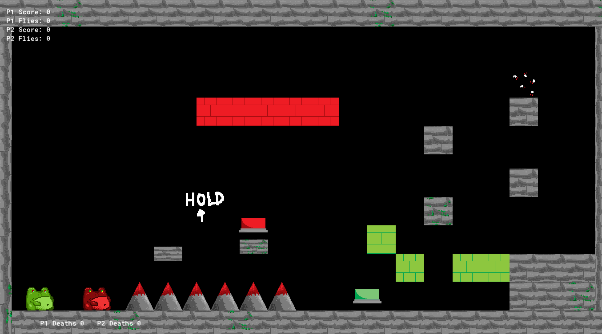
First Day 06/08/2024
Code, objects and sounds, were incredibly similar to Frog Dynasty III. This allowed me to have a very strong base to go off of and due to this I had:
Created a working second player, which is able to interact with objects and moves with arrow keys.
Started on two types of blockades, green blockades and red blockades. The two are connected to buttons of their respective colours. Pressing the green button can only be done by the green frog and removes the green blockades, with the blockades returning when the button isn’t being pressed. Pressing the red button can only be done by the red frog and creates red blockades that disappear while the red button isn’t pressed. I thought originally that doing it that they both destroy the blockades but decided that it would be more mechanically interesting for it to work that way.
Made an exit to the levels that must be in contact with both players to win.
Checklist of things to accomplish by the end:
2 player local multiplayer
10 different levels of increasing difficulty
Enemy that walks back and forth along a platform
Enemy that chases the players
Interesting story
Charged Jump mechanic
Buttons and Blockades that are colour coded

Slide 4
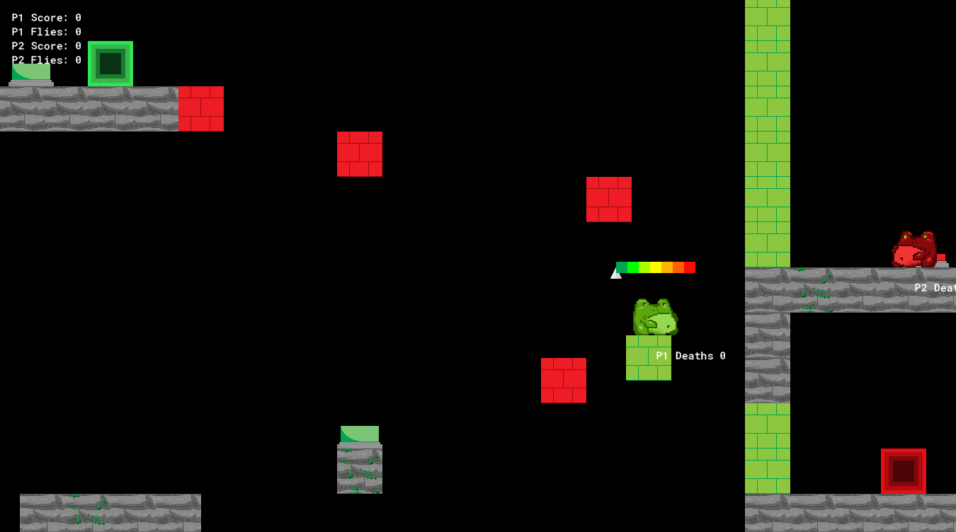
Second Day 08/08/2024
Checklist of things to accomplish by the end:
2 player local multiplayer
10 different levels of increasing difficulty
Enemy that walks back and forth along a platform
Enemy that chases the players
Interesting story
Charged Jump mechanic
Buttons and Blockades that are colour coded
Learned how to make collision with blockades work by parenting them to the walls – they're done now!
Utilised global variables to let multiple instances of a button not break the entire blockade system of that colour.
Sort of fixed the jump bars that show jump power, they still have erratic behaviour if you try to break them but lock to the end of the bar when jump power is maxed. Will try to make them work super-duper well as a stretch goal
Added 1 level
Lowered jump height max, as I felt it was too powerful

Slide 5
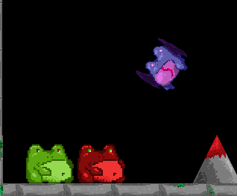
Third Day 13/08/2024
Made enemy from Frog Dynasty III that chases, but he chases the closest player so teamwork can be utilised to reach certain places easier. Will change some aspects of it, and definitely create a cooler sprite. Could also add specific chasing enemies that chase one player in particular.
Changed the way that the goal works by making two exits – one red and one green that each frog must reach the exit that matches their colour to escape.
Finished second level to make it work well and involve a large portion of teamwork to complete.
Checklist of things to accomplish by the end:
2 player local multiplayer
10 different levels of increasing difficulty
Enemy that walks back and forth along a platform
Enemy that chases the players
Interesting story
Charged Jump mechanic
Buttons and Blockades that are colour coded

Slide 6
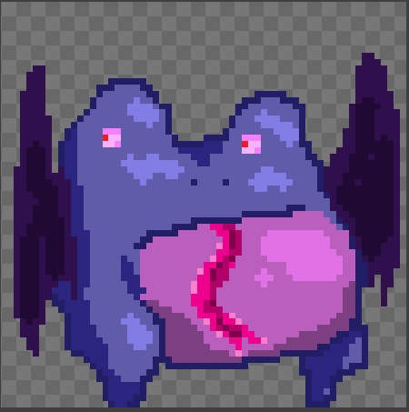
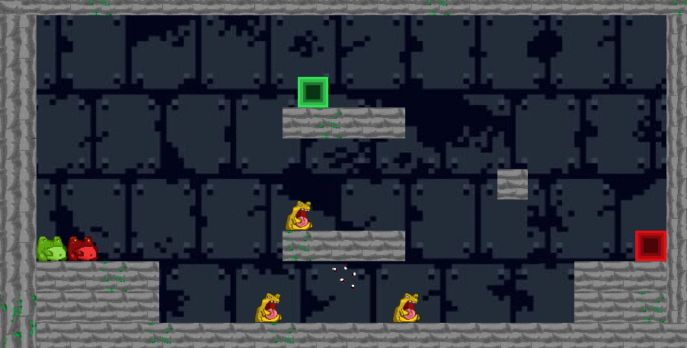
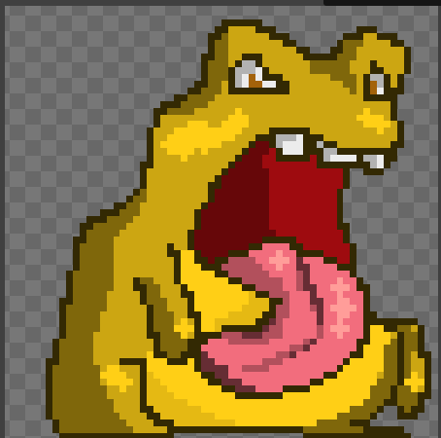
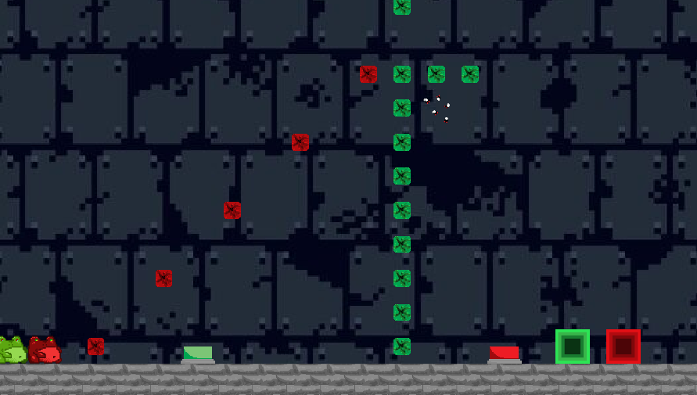
Fourth Day 15/08/2024
Changed Sprite of chasing enemy to a bat-like frog.
Added an enemy that walks along the ground until it hits a wall or would fall off of a platform. When it is not on a platform it annoyingly rapidly switches facing direction, not sure what to do to fix it but I will deal with it tomorrow.
Decided that I’m going for a frog themed creature sprites for this game.
Created two new levels, one to showcase this new walking enemy. And another to use as an introduction to the buttons. 4/10 complete.
May in future add animation to the sprites instead of the still images, currently can’t be bothered to be honest.
Checklist of things to accomplish by the end:
2 player local multiplayer
10 different levels of increasing difficulty
Enemy that walks back and forth along a platform
Enemy that chases the players
Interesting story
Charged Jump mechanic
Buttons and Blockades that are colour coded

Slide 7
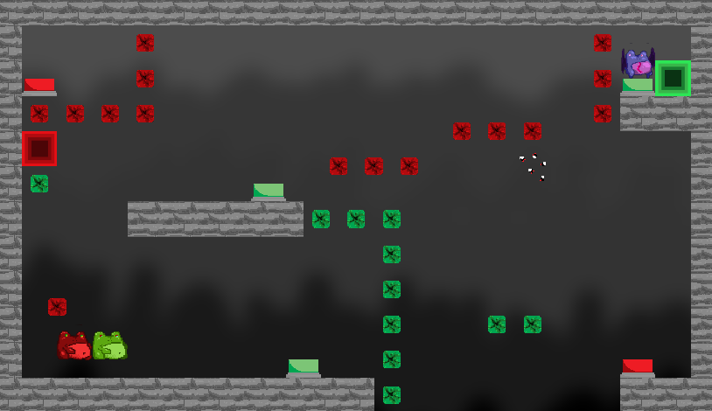
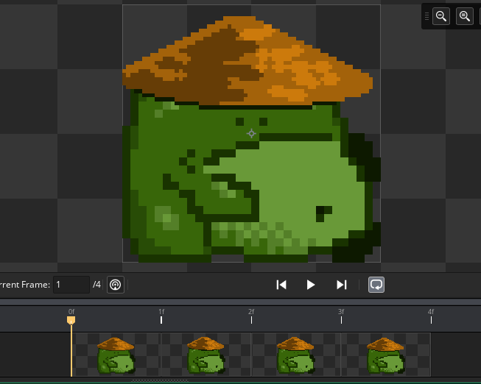
Fifth Day 20/08/2024
New level to showcase flying enemy. Pretty difficult level which is good.
Decided to make it that enemies can be killed by spawning the blockades on top of them but was unable to get it to work this day. Current attempt to have this work was by using a place meeting check each step to see if the enemy was inside the blockades but instead of destroying the enemy it destroyed the blockade and as such it started to eat the blockades. Will fix later
Drew sprite for something I might use later in the game for a boss or an NPC to talk to
Checklist of things to accomplish by the end:
2 player local multiplayer
10 different levels of increasing difficulty
Enemy that walks back and forth along a platform
Enemy that chases the players
Interesting story
Charged Jump mechanic
Buttons and Blockades that are colour coded

Slide 8
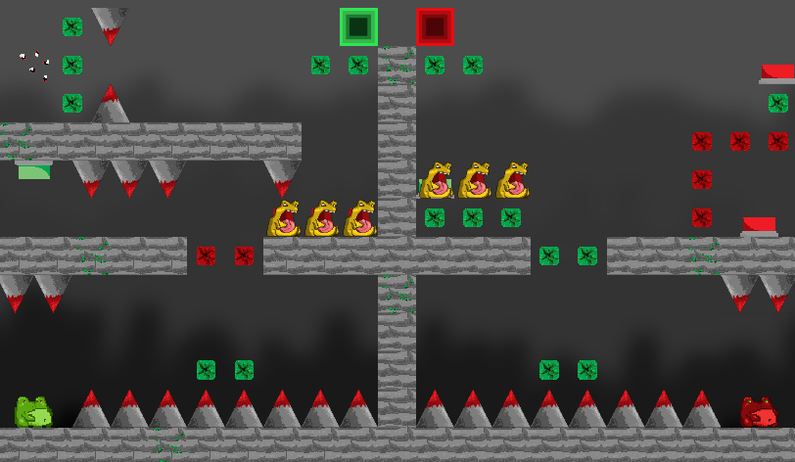
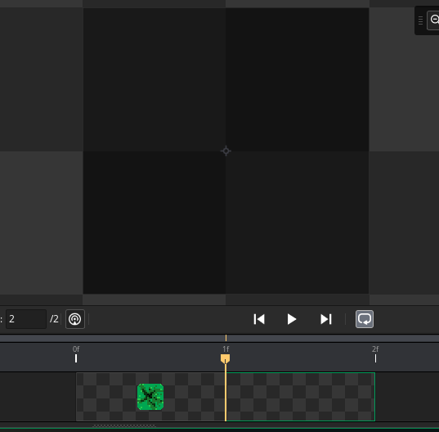
Sixth Day 22/08/2024
Fixed enemies eating the blockades by instead of checking for the blockade itself it checks for the spawner when it is in its spawned object frame that shows nothing but still has collision.
Made difficult level that involves killing enemies to progress. This level is very difficult and revolves around both players being in sync with one another.
Begun ramping the difficulty of these levels to the appropriate amount
Checklist of things to accomplish by the end:
2 player local multiplayer
10 different levels of increasing difficulty
Enemy that walks back and forth along a platform
Enemy that chases the players
Interesting story
Charged Jump mechanic
Buttons and Blockades that are colour coded

Slide 9
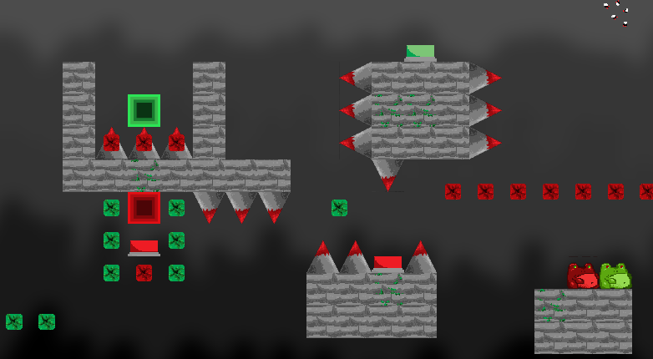
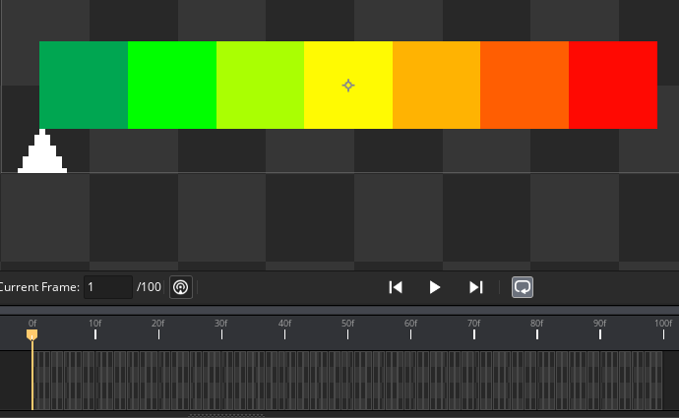
Seventh Day 27/08/2024
Couldn’t fix the problems with the jump arrow while charging the jump so decided to change the entire thing to a hundred-pixel long sprite with a frame for each tenth of the jump power of each frog. This was so dumb of an idea but works so well now and I haven’t had any issues with moving in the air while charging or walking into walls while charging.
Made new level that is even more difficult than the last, requiring large amounts of precision and being almost perfectly in sync with each other.
Checklist of things to accomplish by the end:
2 player local multiplayer
10 different levels of increasing difficulty
Enemy that walks back and forth along a platform
Enemy that chases the players
Interesting story
Charged Jump mechanic
Buttons and Blockades that are colour coded

Slide 10
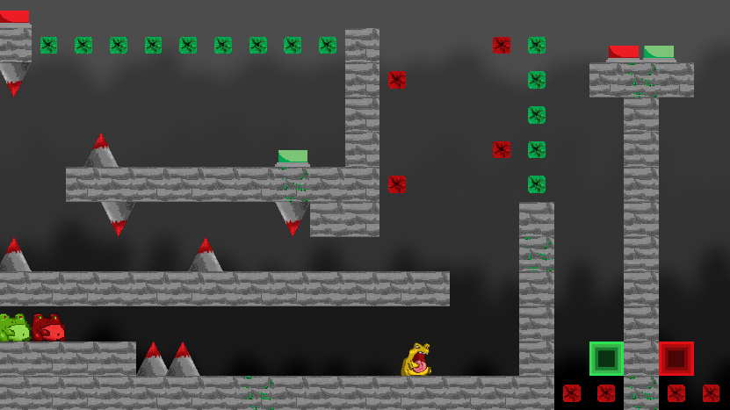
Eighth Day 29/08/2024
New level! It’s way harder than it looks! The first jump is pixel perfect followed by the enemy that is also pixel perfect to jump over, followed by difficult jumps in order to progress.
Got people to playtest the game and they had so much fun together dying over and over.
Decided to use the tenth level as a boss fight against the frog sprite from before. The fight will consist of surviving against the frog’s attacks until he tires out then killing him
Attacks will involve a slash towards the nearest player, a tongue that shoots towards the furthest player and a charge along a line with both players
Checklist of things to accomplish by the end:
2 player local multiplayer
10 different levels of increasing difficulty
Enemy that walks back and forth along a platform
Enemy that chases the players
Interesting story
Charged Jump mechanic
Buttons and Blockades that are colour coded

Slide 11
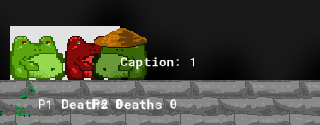
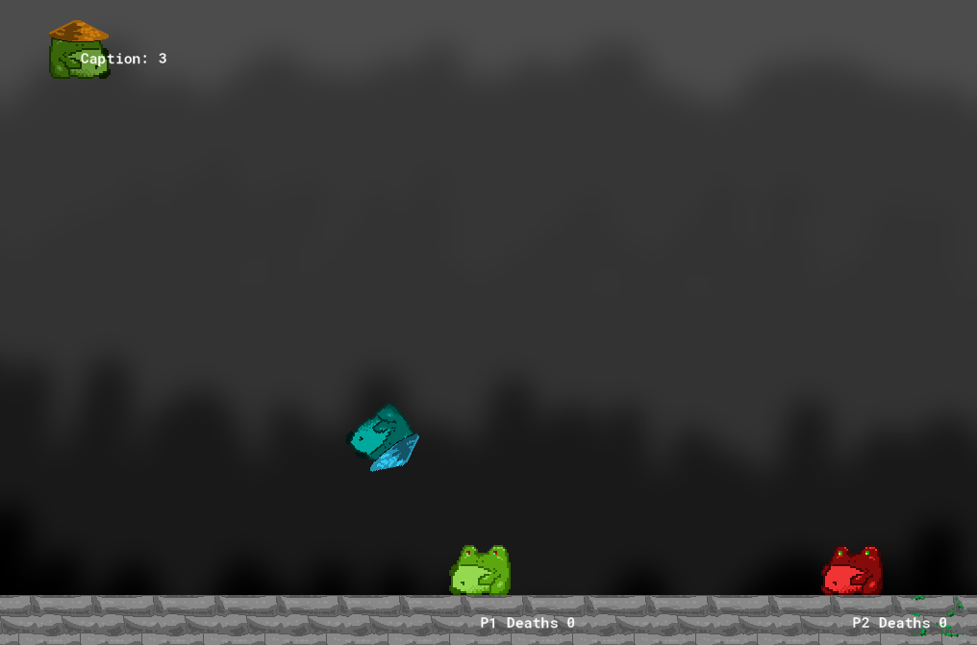
Ninth Day 3/9/2024
Slash attack is done, I didn’t realise it would act the way it does but I like it more to be honest. Something keeps him moving constantly until he slashes which makes it look like there's a big attack coming.
Tongue is mostly complete, had the idea to make the tongue length act as a wall and allow players to stand on it but at the moment I couldn’t figure out how to get the wall collision to not check for the length when I had it as a child.
Had no idea how to make a line attack so I ended up making him fire mirages of himself towards the target.
Will make good sprites for attacks later on.
Checklist of things to accomplish by the end:
2 player local multiplayer
10 different levels of increasing difficulty
Enemy that walks back and forth along a platform
Enemy that chases the players
Interesting story
Charged Jump mechanic
Buttons and Blockades that are colour coded

Slide 12
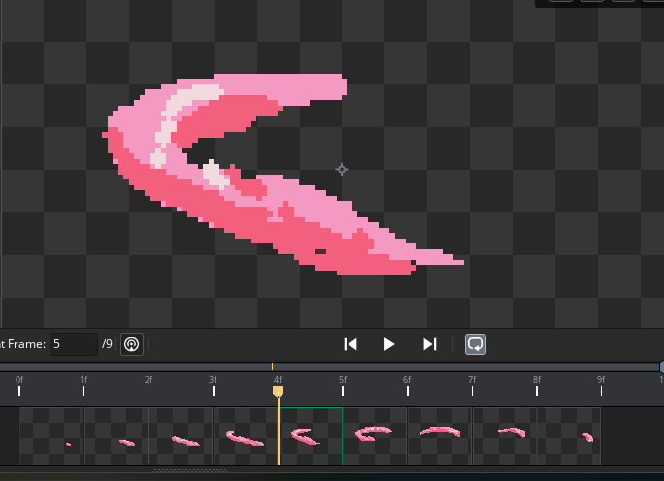
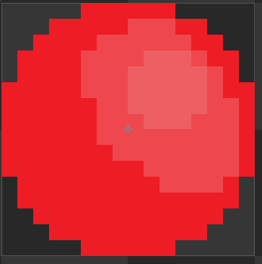
Tenth Day 5/9/2024
Added slash animation to the slash attack
Turned the tongue into a nice circle
Used a parent to have for all walls. This allows me to have the tip collide with the platforms but not the length of its own tongue, so the players can walk on the tongue.
Checklist of things to accomplish by the end:
2 player local multiplayer
10 different levels of increasing difficulty
Enemy that walks back and forth along a platform
Enemy that chases the players
Interesting story
Charged Jump mechanic
Buttons and Blockades that are colour coded

Slide 13
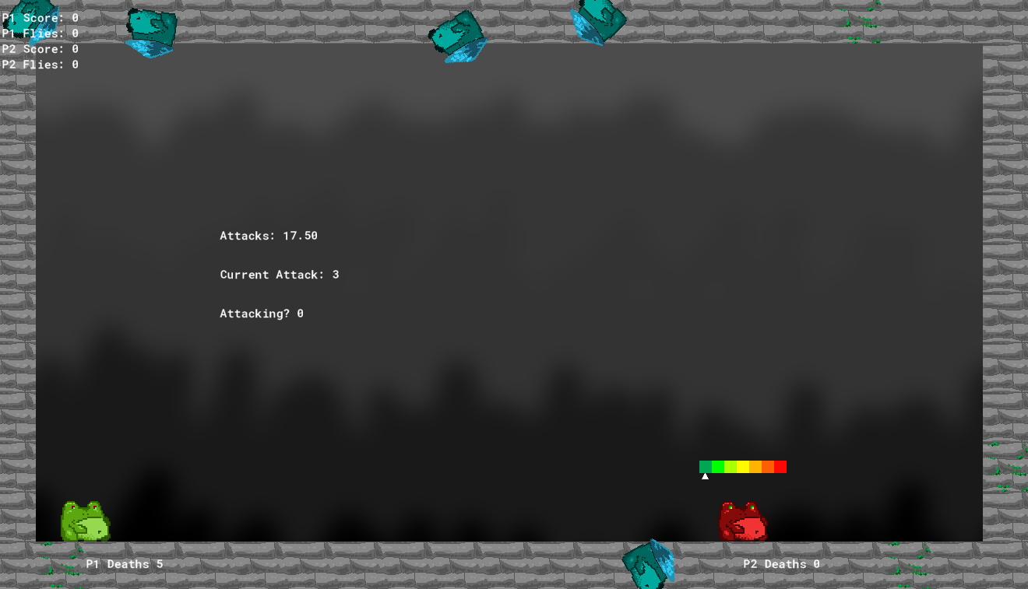
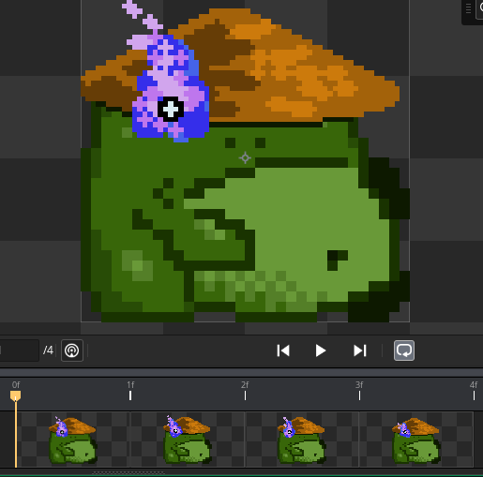
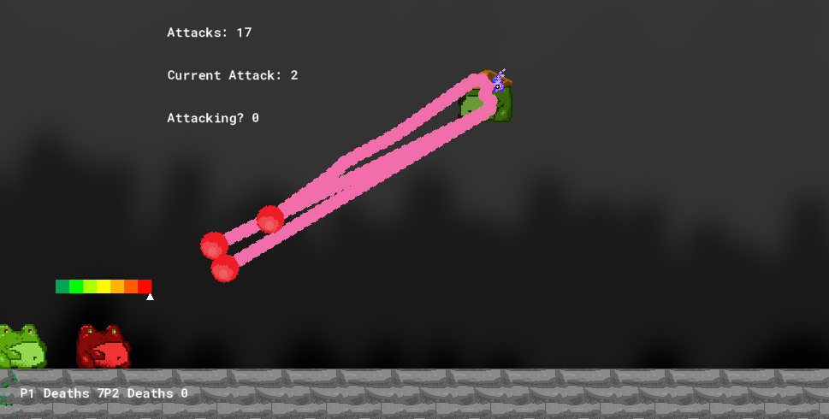
Eleventh and Twelfth Days 10/9/2024 and 12/9/2024
Added second phase with attacks that turn the first phase look like a cake walk
Slash attack is the same so far in second phase
Tongue attack has three tongues now with pathfinding. One for each player and another for whoever is closest
Mirage attack now does three bursts of creating five mirages around the edge of the stage
To balance these attacks each one takes up differing amounts of attacks so he will attack less if he uses more difficult attacks
Checklist of things to accomplish by the end:
2 player local multiplayer
10 different levels of increasing difficulty
Enemy that walks back and forth along a platform
Enemy that chases the players
Interesting story
Charged Jump mechanic
Buttons and Blockades that are colour coded

Slide 14
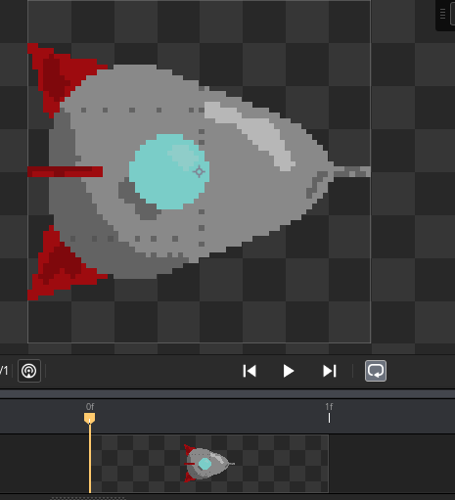
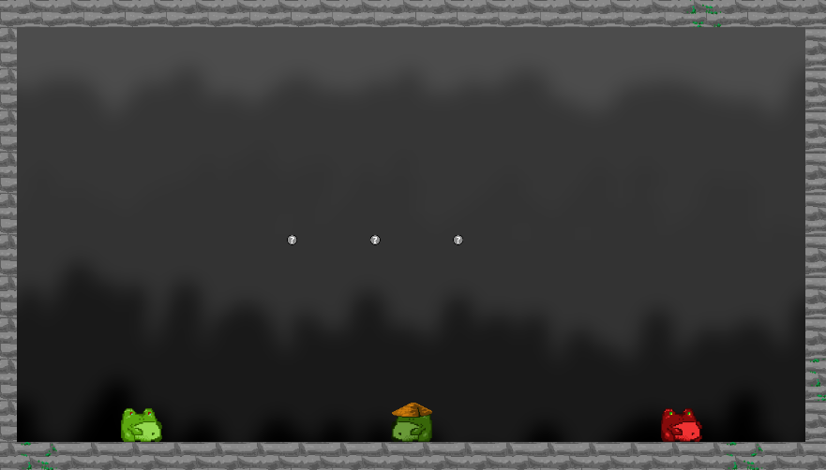
Thirteenth and Fourteenth Days 17/9/24 & 19/9/24
Finished boss fight up mechanically and tweaked the attack amount, changing the amount of attacks consumed by each attack. This makes harder to dodge attacks consume the boss’s ‘stamina’ quicker, so surviving harder attacks makes the fight shorter
Began adding sound to his attacks as polish
Added multiple endings, including an ending where you kill the boss by sending him to hell in a rocket, one where you wait for him to get too tired to fight, a freaky ending, and a super-secret add-on to the killing ending. Each has its own requirements for unlocking.
Checklist of things to accomplish by the end:
2 player local multiplayer
10 different levels of increasing difficulty
Enemy that walks back and forth along a platform
Enemy that chases the players
Interesting story
Charged Jump mechanic
Buttons and Blockades that are colour coded

Slide 15
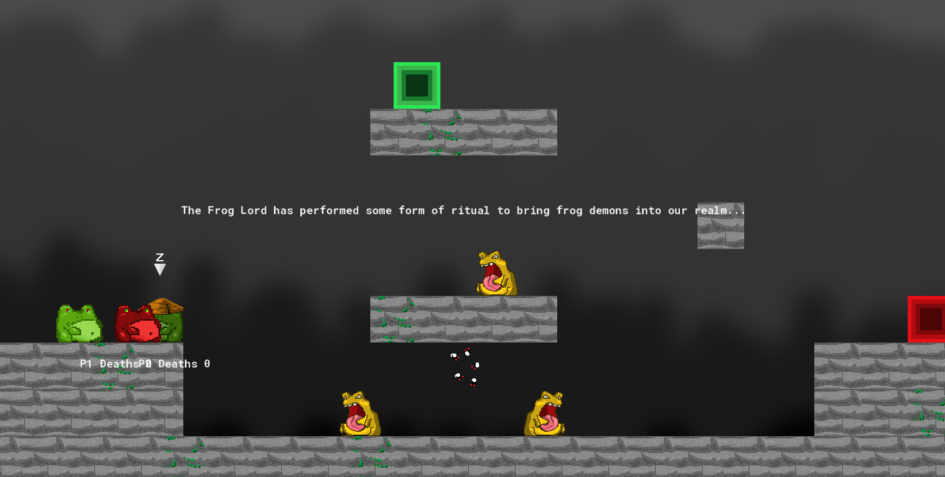
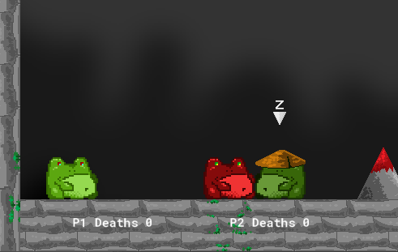
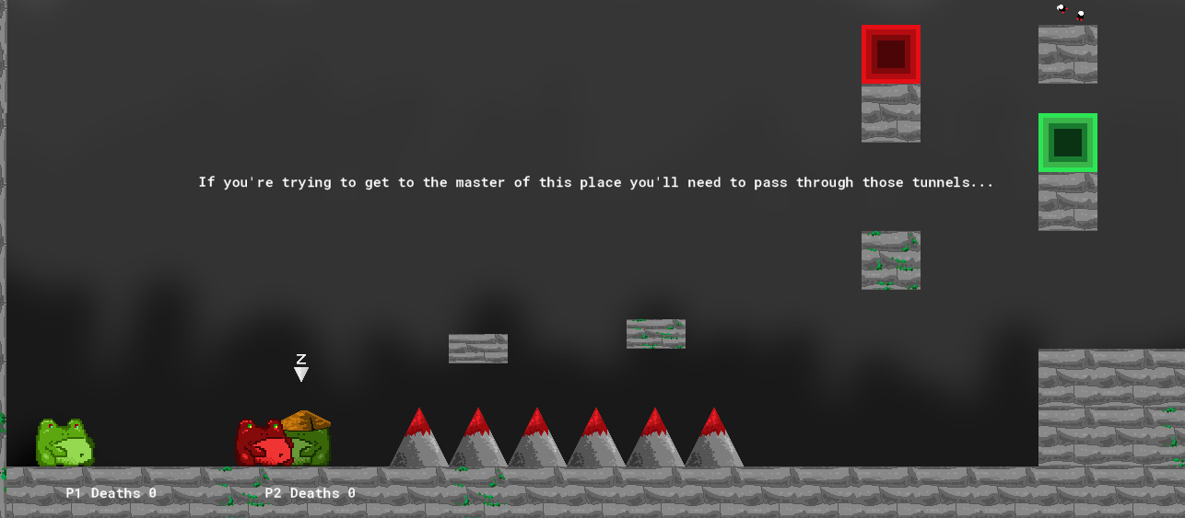
Fifteenth and Sixteenth Days 24/9/24 & 26/9/24
Added sound to the things I forgot to last time
Made a sound that the flies play that gets louder the closer a player gets to it using gain and distance variables.
Began adding a story through the samurai frog who becomes the bad guy at the end
Dialogue system added to let the player talk to the samurai and he will explain how things work, how to jump around, and can hint on beating the level
Checklist of things to accomplish by the end:
2 player local multiplayer
10 different levels of increasing difficulty
Enemy that walks back and forth along a platform
Enemy that chases the players
Interesting story
Charged Jump mechanic
Buttons and Blockades that are colour coded

Slide 16
Seventeenth and Eighteenth Days 15/10/24 &17/10/24
Attempted to make music in the game
Found cool songs for boss themes, the Molduga battle theme and Ganon battle theme each from the Legend of Zelda: Breath of the Wild
Fun songs for the non-boss levels, Animal Crossing main theme and the Underground song from Terraria
Couldn’t get it to work, will do next Tuesday.

Slide 17
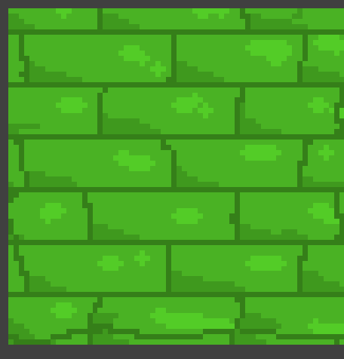
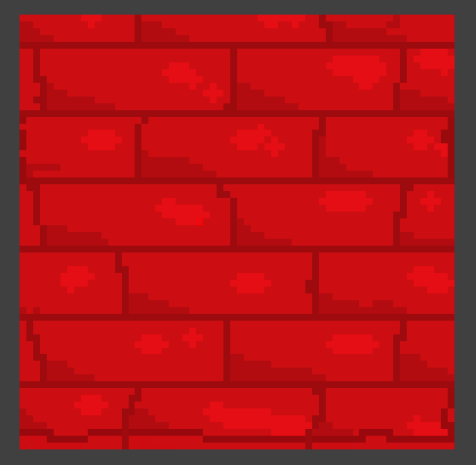
Nineteenth Day 31/10/24
Finished adding sound effects
Made boss tongue last less time so it doesn’t kill you immediately
Changed sprite of blockades because they were ugly

